Slide 1
ALGEBRA 4
Day 59

Slide 2
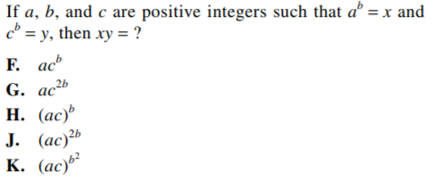
Bell Work

Slide 3
Things to Study
Level 2:
Fundamental Counting Principal Combination & Permutation Probability Mutually Exclusive Independent vs Dependent
Level 3:
Set up & Solve Combination and Permutation Probability with multiple events
Level 4:
Set up and solve your own probability problems

Slide 4
Quiz: Level 2
You have 10 shirts and 8 pairs of pants. How many outfits could you wear?
A bag has 6 red, 4 green, and 10 blue marbles.
Find P(green) P(not red)
Is the following independent or dependent: a student flips a coin and they roll an even number on a die?

Slide 5
Quiz: Level 2
You have 10 shirts and 8 pairs of pants. How many outfits could you wear? Answer: 80
A bag has 6 red, 4 green, and 10 blue marbles.
Find P(green) P(not red)
Is the following independent or dependent: a student flips a coin and they roll an even number on a die?

Slide 6
Quiz: Level 2
You have 10 shirts and 8 pairs of pants. How many outfits could you wear? Answer: 80
A bag has 6 red, 4 green, and 10 blue marbles.
Find P(green) P(not red) Answer: 4/20 Answer: 14/20
Is the following independent or dependent: a student flips a coin and they roll an even number on a die?
Answer: Independent

Slide 7
Quiz: Level 3
If you have 6 novels, and 4 comic books in your backpack. How many ways can you randomly select two of them to read?
A bag has 6 red, 4 green, and 10 blue marbles.
Find P(green or red)
P(red then red) [with & without replacement]

Slide 8
Quiz: Level 3
If you have 6 novels, and 4 comic books in your backpack. How many ways can you randomly select two of them to read?
Answer: 10C2 = 45
A bag has 6 red, 4 green, and 10 blue marbles.
Find P(green or red) Answer: 10/20 P(red then red) with without Answer: 6/20 * 6/20 6/20 * 5/19
9/100 3/38

Slide 9
Quiz: Level 4
The dance coach has decided to randomly choose 4 players to represent the team as captains. The team consists of 12 seniors and 8 juniors. What is the probability that only one senior will be chosen at random?

Slide 10
Quiz: Level 4
The dance coach has decided to randomly choose 4 players to represent the team as captains. The team consists of 12 seniors and 8 juniors. What is the probability that only one senior will be chosen at random?
(12C1 / 20C4) = 12/4845
= 4/1615 = 0.00247 = 0.247%

Slide 11
Review Assignment
Page 752 #5-31
Page 757 #1-10, 18, 20

